Slide 1

CSCI-455 Senior Project
Midsemester Report
Aloysius Arno Wiputra 1244139
Hetul Patel 1250935
Ruchira Bunga 1262634

Slide 2
summary of tasks
1
version control
database hosting
scraper design
back end coding
2
encryption design
database design
Input sanitation design
machine learning implementations
3
design language
logo design
Individual page designs
front end coding

Slide 3
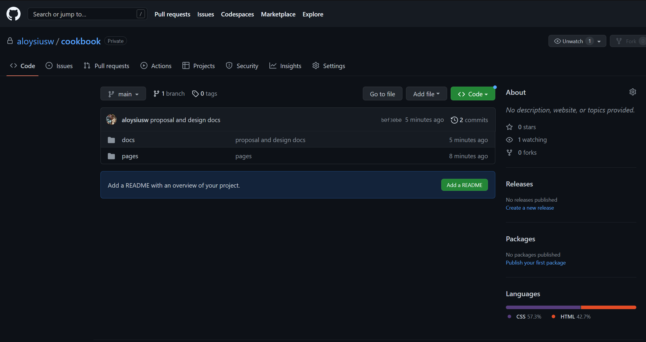
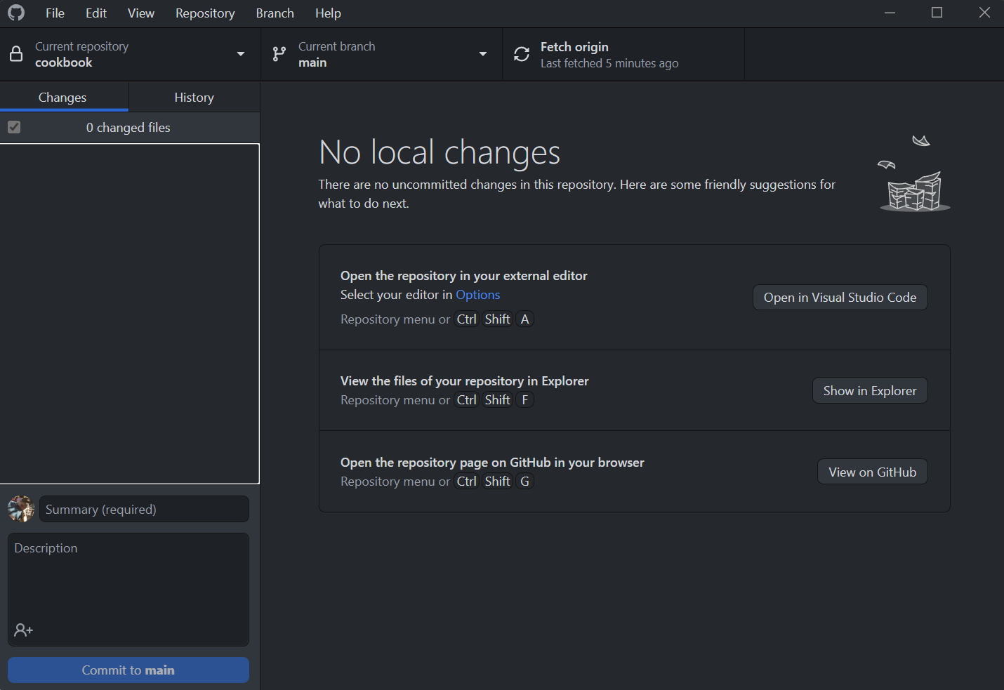
1
progress report
Currently version control is being hosted in GitHub
https://github.com/aloysiusw/cookbook
Using a tool called “GitHub Desktop”
Need to be shared with project members
version control

Slide 4
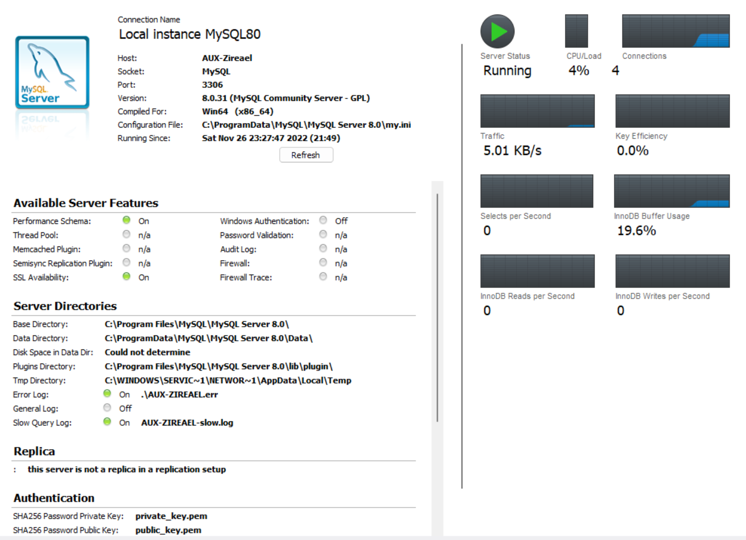
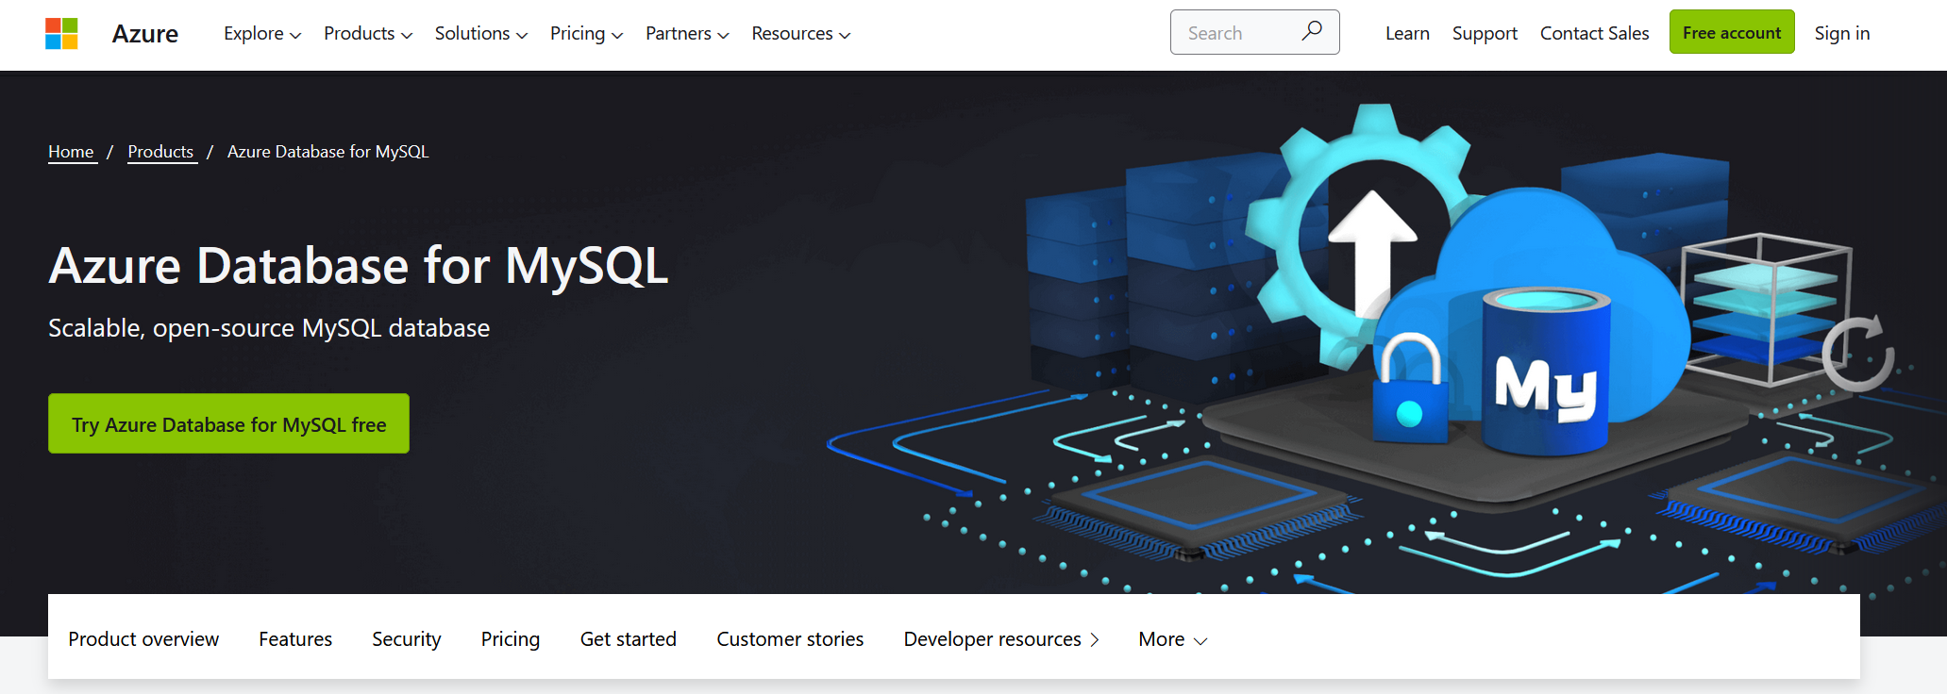
1
progress report
database hosting
Current plan is to use Azure for hosting, services will start once we have the finalized database design to avoid overcharge
Currently using local machine instance

Slide 5
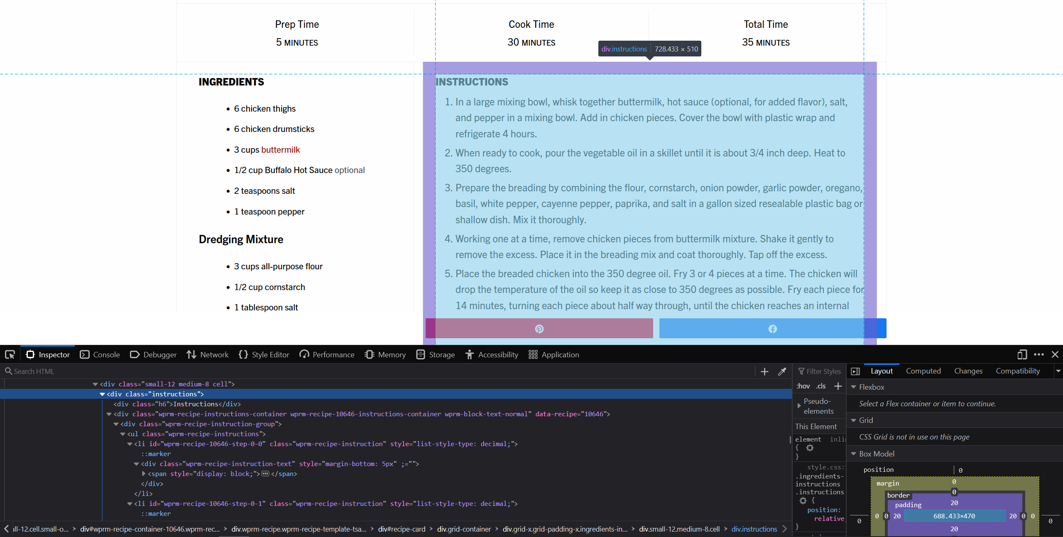
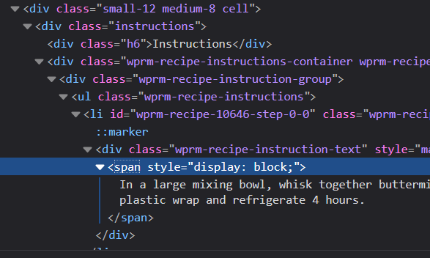
1
progress report
scraper
design
Current idea is to have whitelisted domains from a preset list
Each domains have a specific method to scrape
https://thestayathomechef.com/fried-chicken/

Slide 6
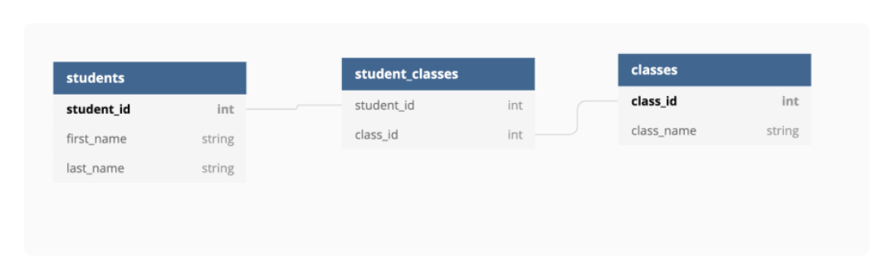
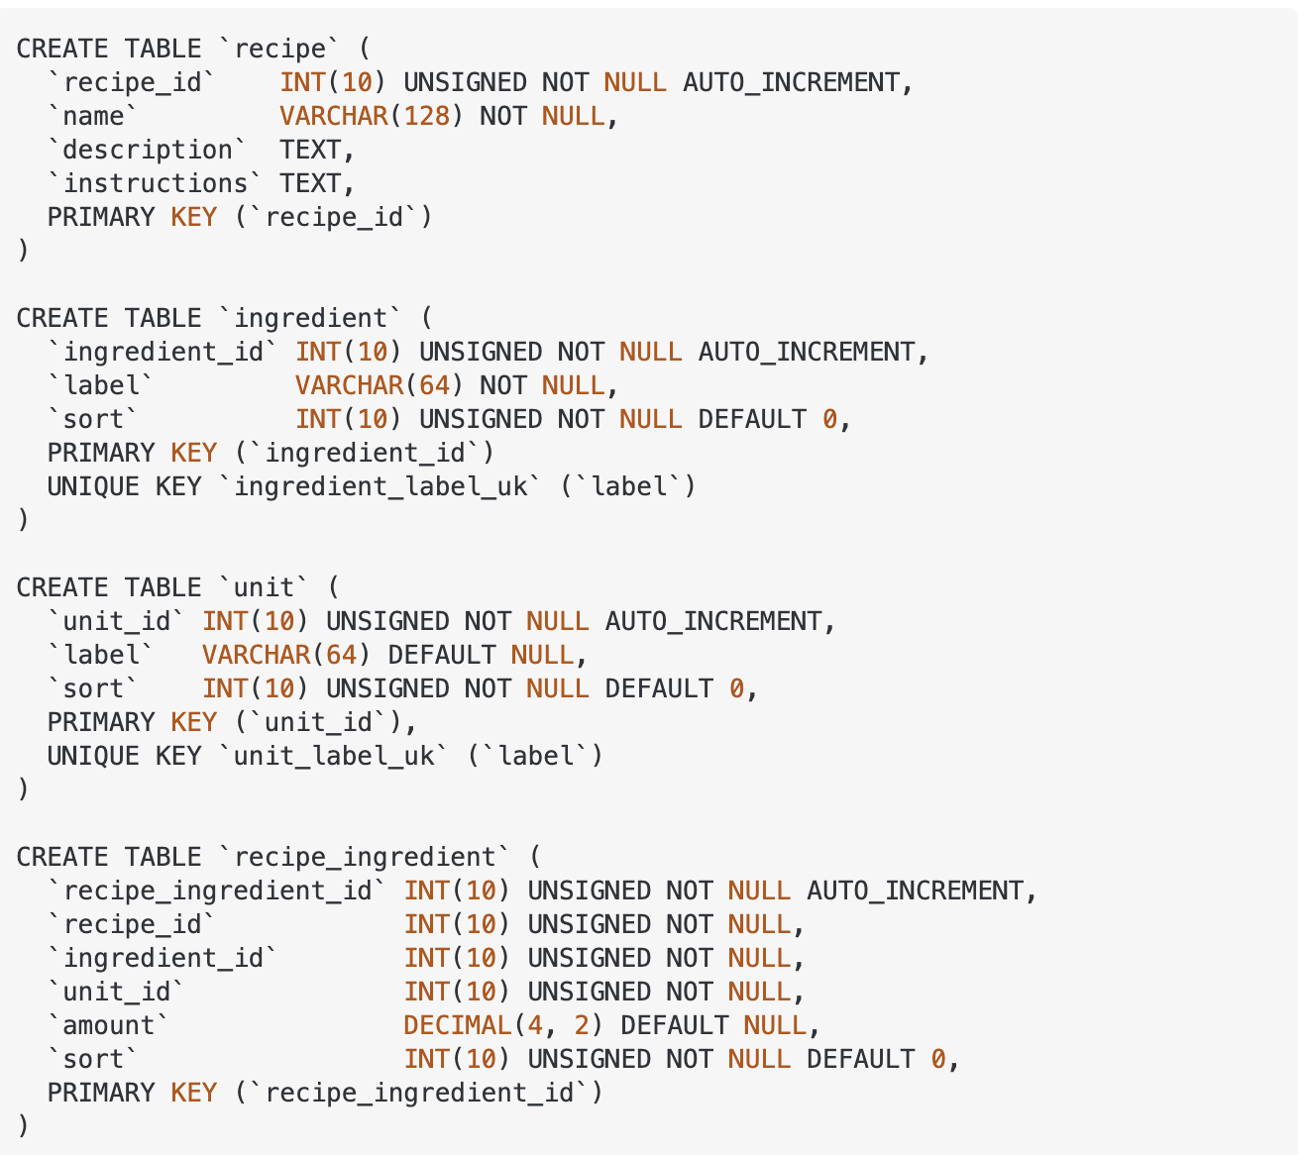
2
progress report
database
design
basic relational database concept research done
https://dev.to/amckean12/designing-a-relational-database-for-a-cookbook-4nj6

Slide 7
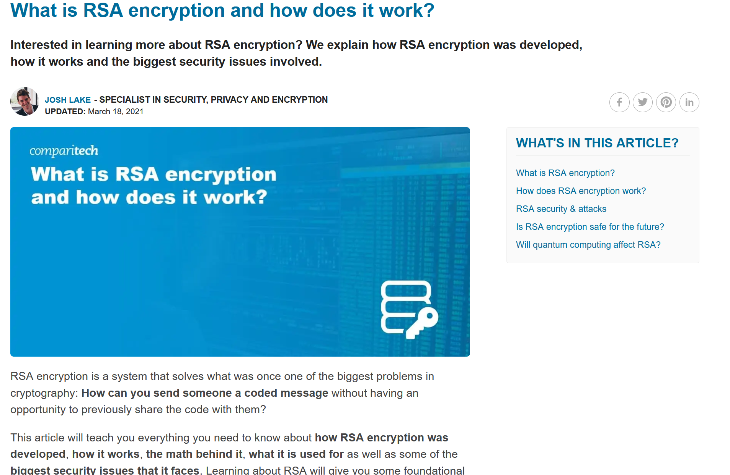
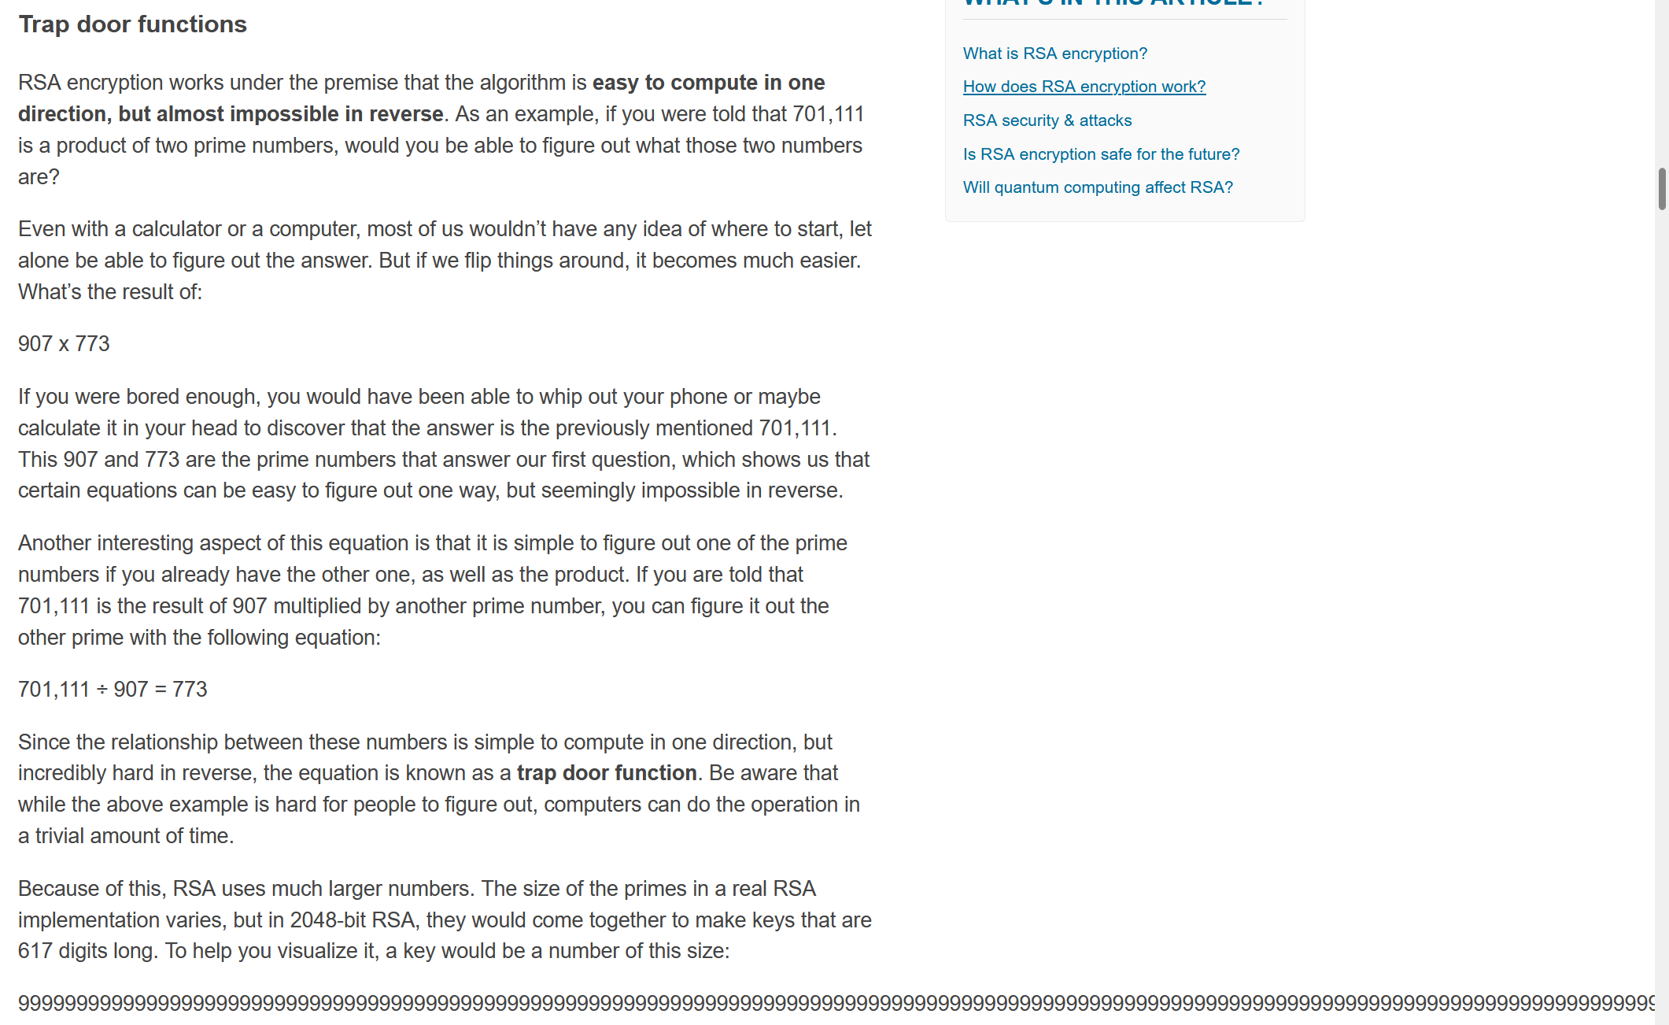
2
progress report
encryption
design
encryption methods has been researched, appropriate design for our implementation is still being looked at
https://www.comparitech.com/blog/information-security/rsa-encryption/

Slide 8
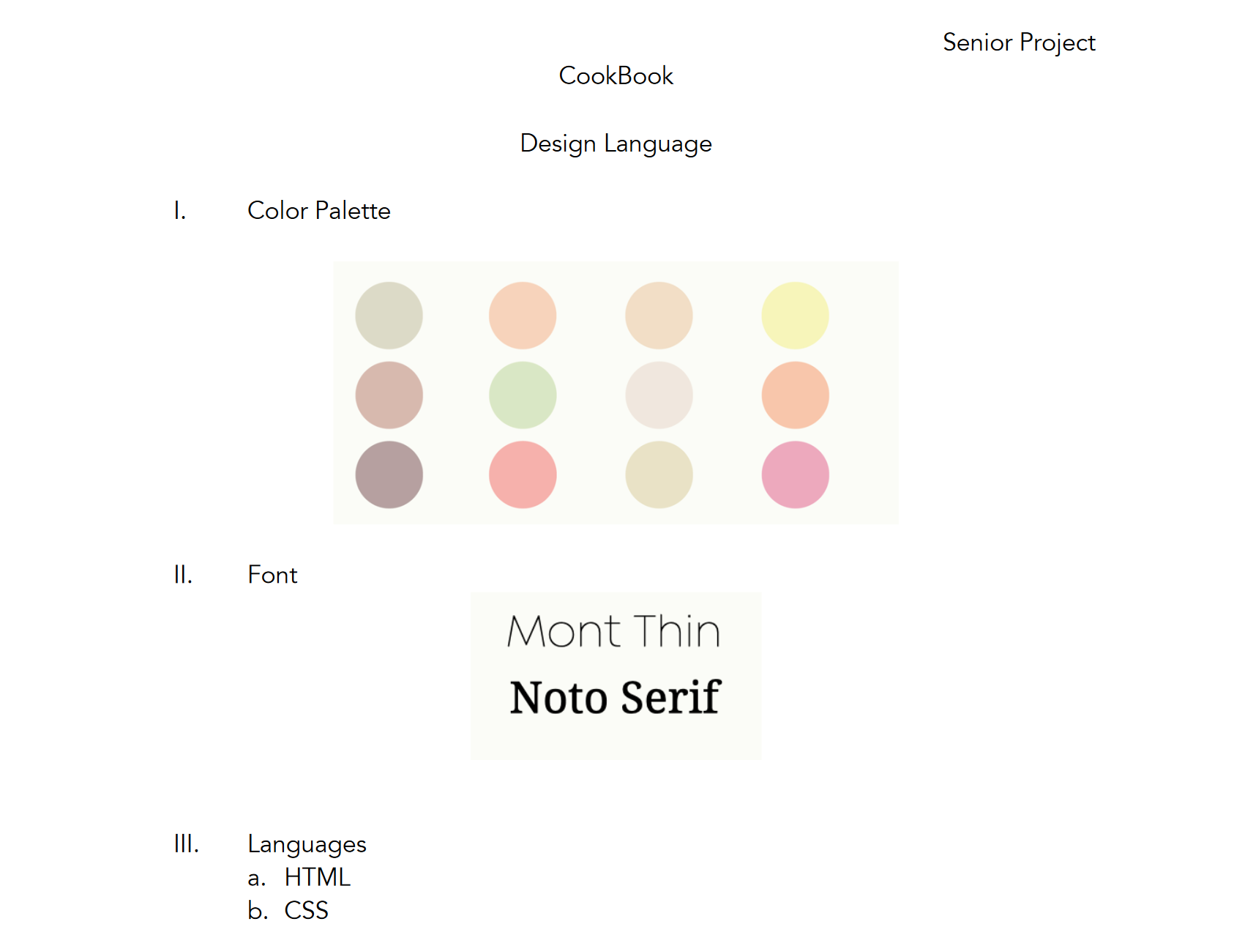
3
progress report
design language
Extensive design language document done, with individual page designs and color palette

Slide 9
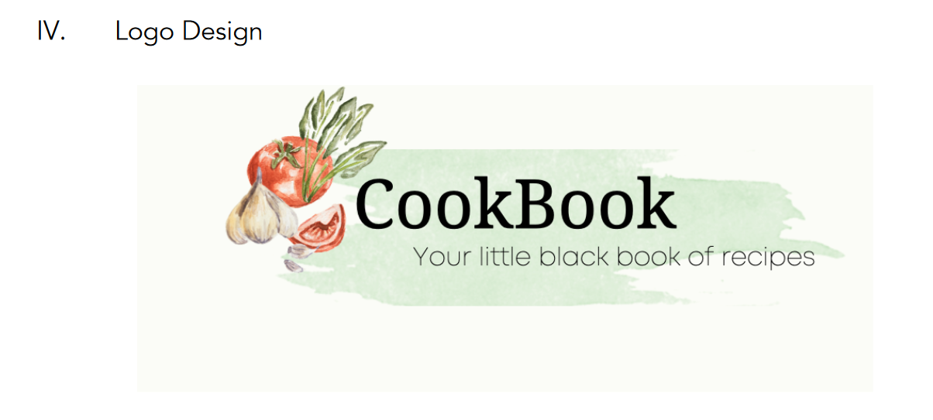
3
progress report
logo design
Logo and banner designed with the aforementioned color palette and font

Slide 10
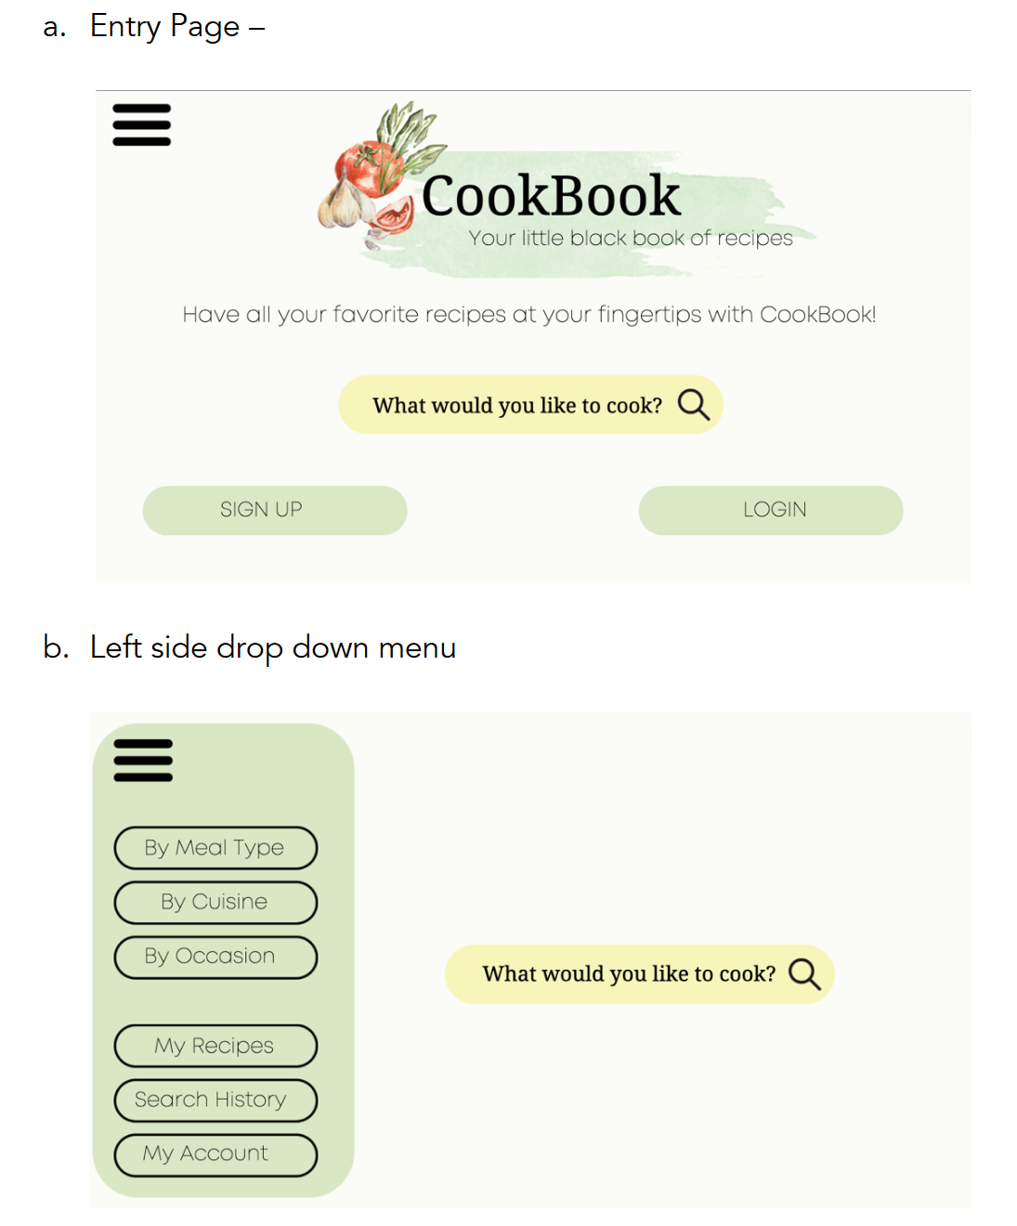
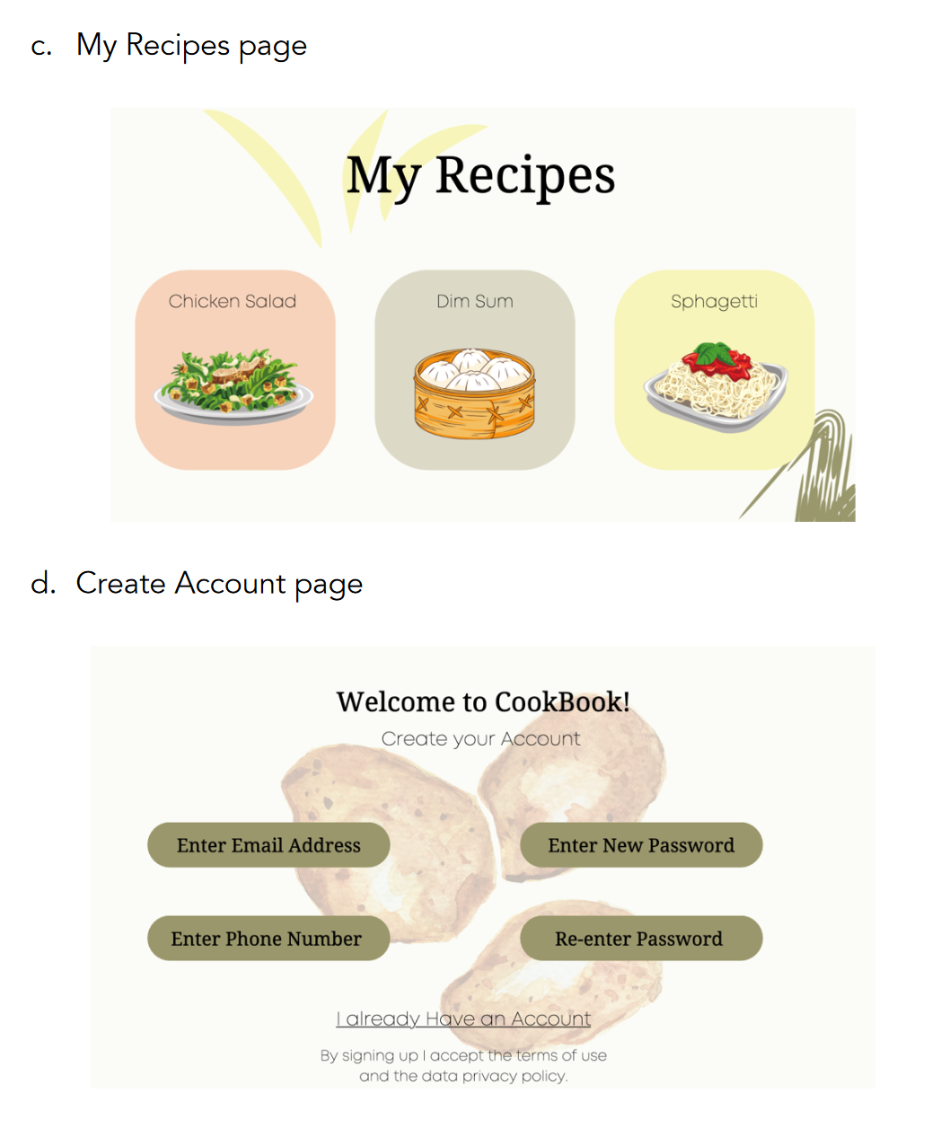
3
progress report
Individual page designs
Design document included the drafts of the individual page designs

Slide 11
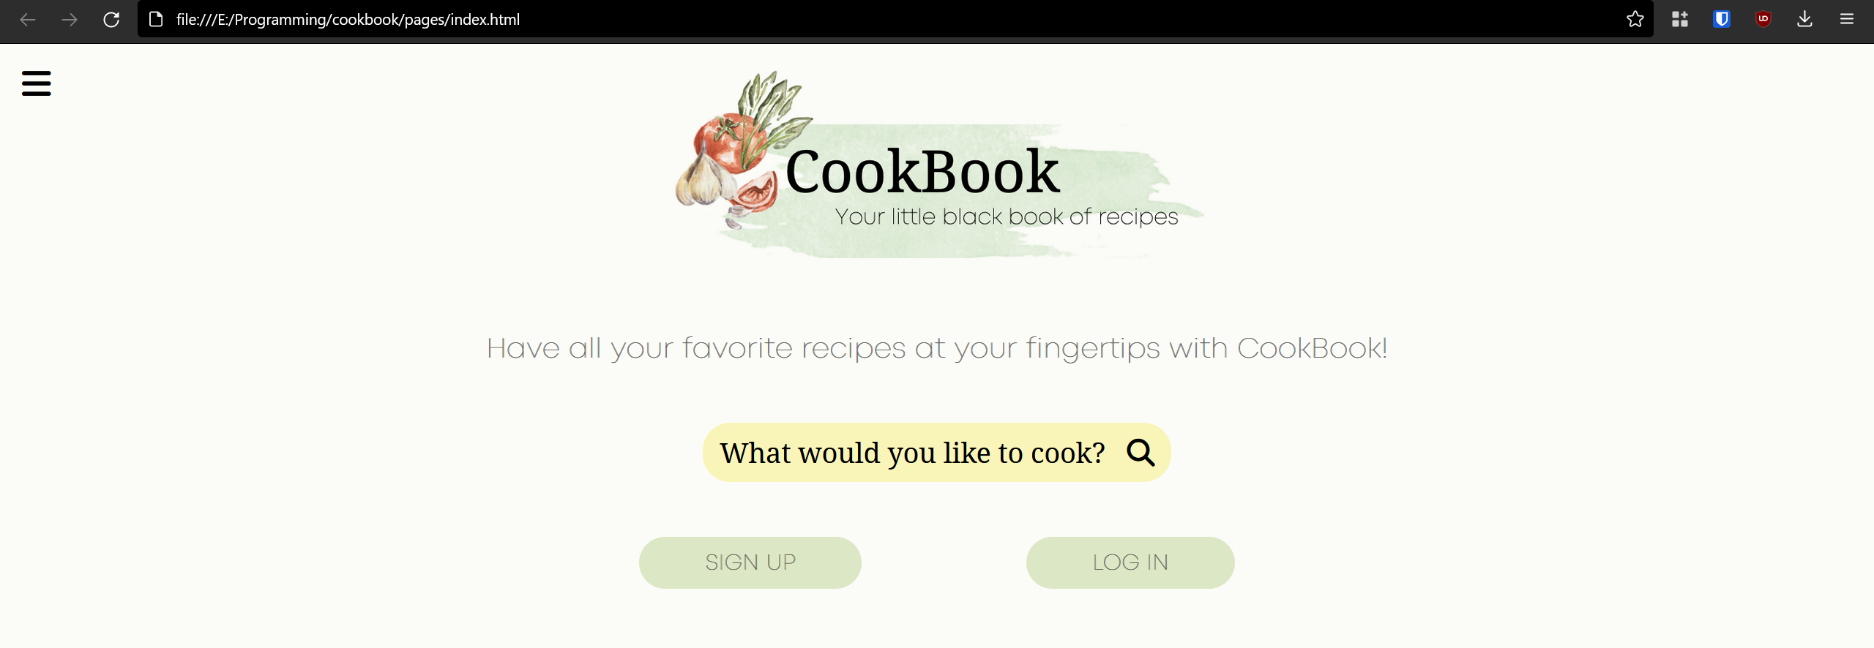
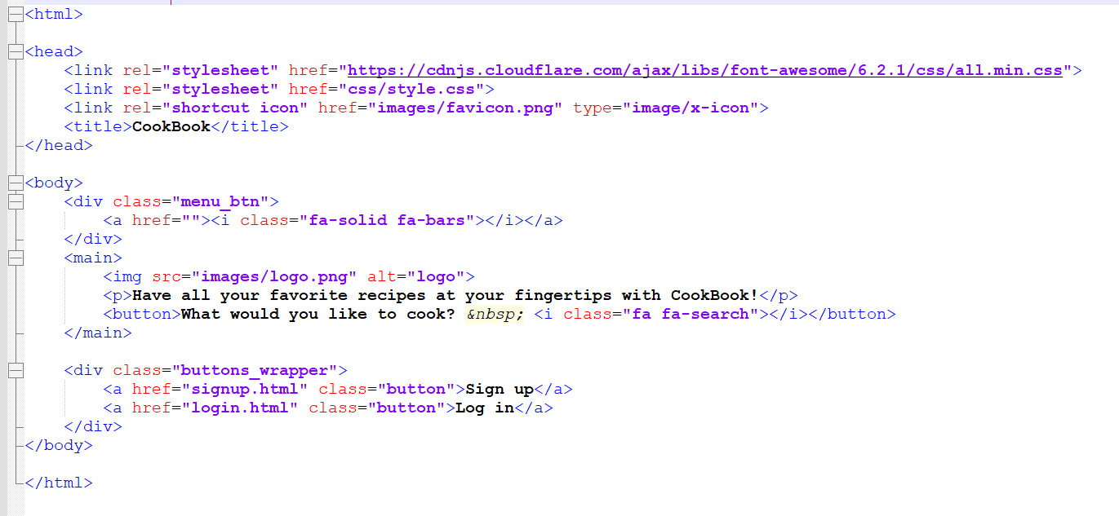
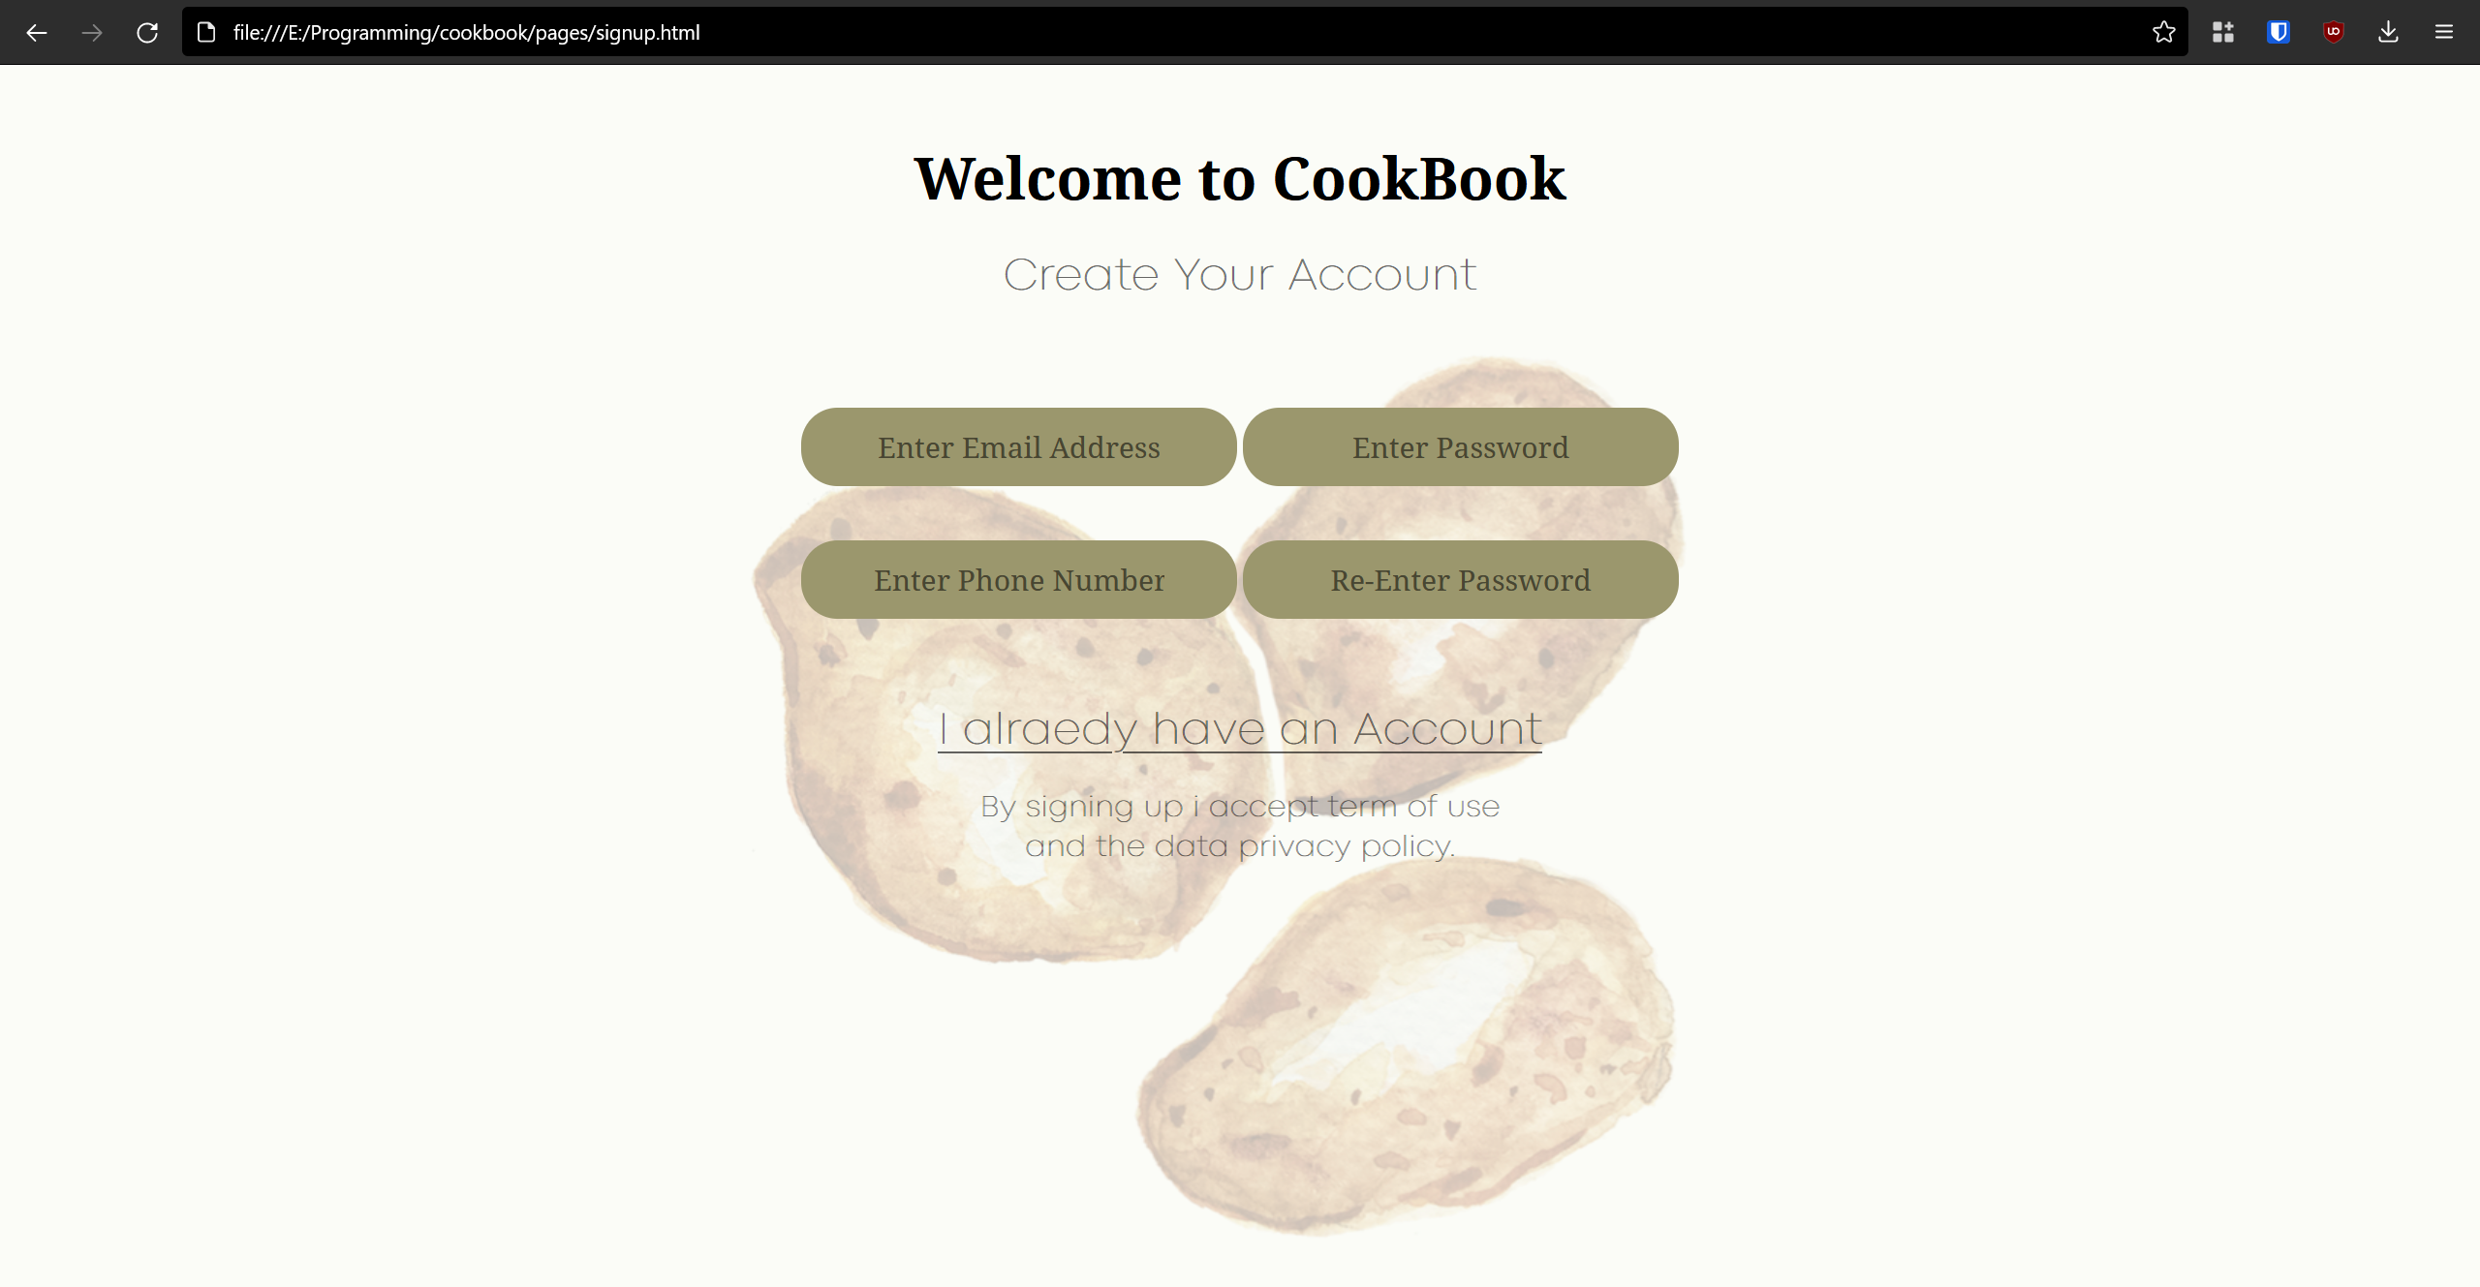
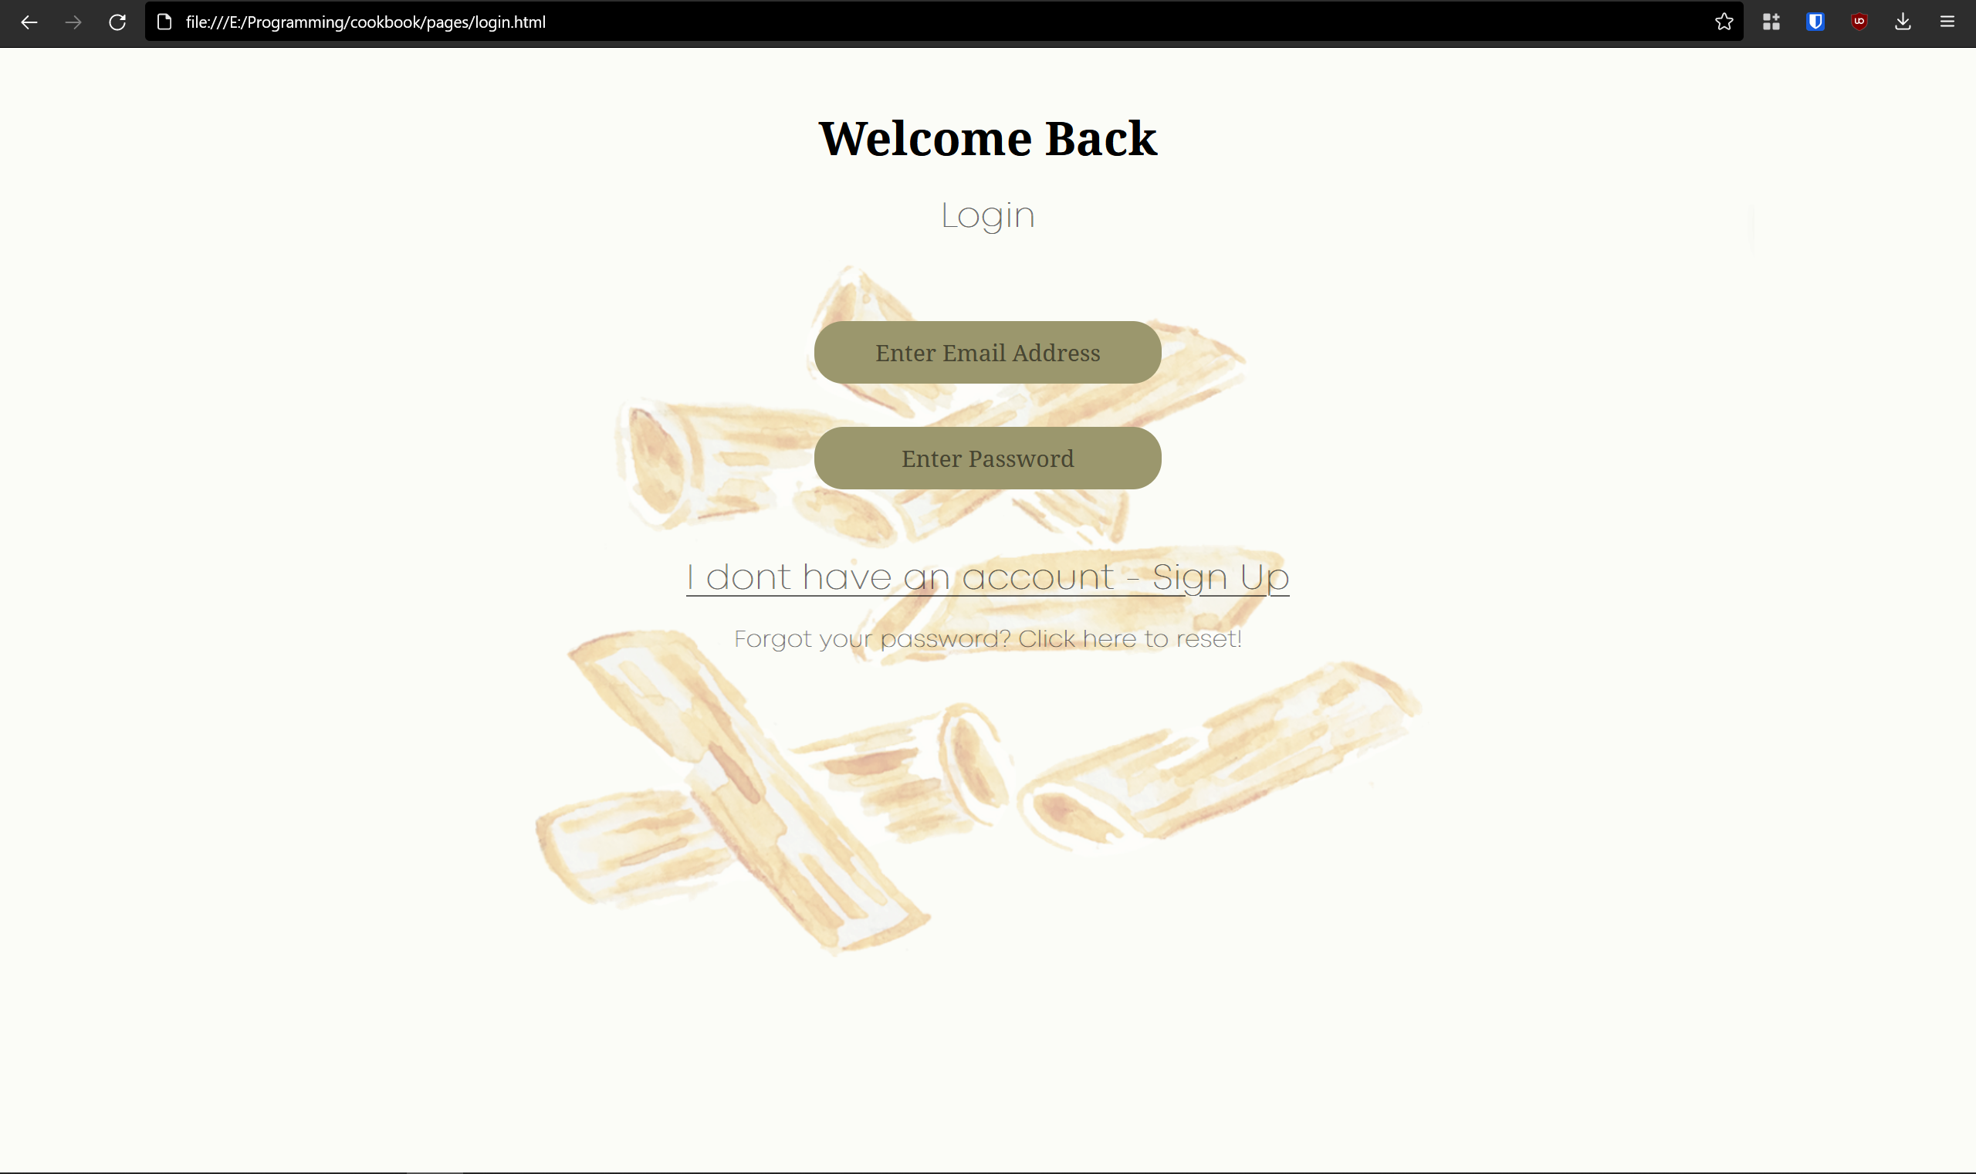
3
progress report
front end coding
Codebase for the designs with html and css has been started

Slide 12
T H A N K Y O U

